Slide 1
Programming Language: AROZ
Adrian Lopez
Rodolfo Diaz
Oscar Dominguez
Zijun Zhao

Slide 2
Purpose
The goal of AROZ: A user-friendly programming language targeted towards beginner/new programmers.
We wanted to make Language A much more simpler in terms of Readability and Writeability.
AROZ: Is based off C++, Python, and PHP.

Slide 3
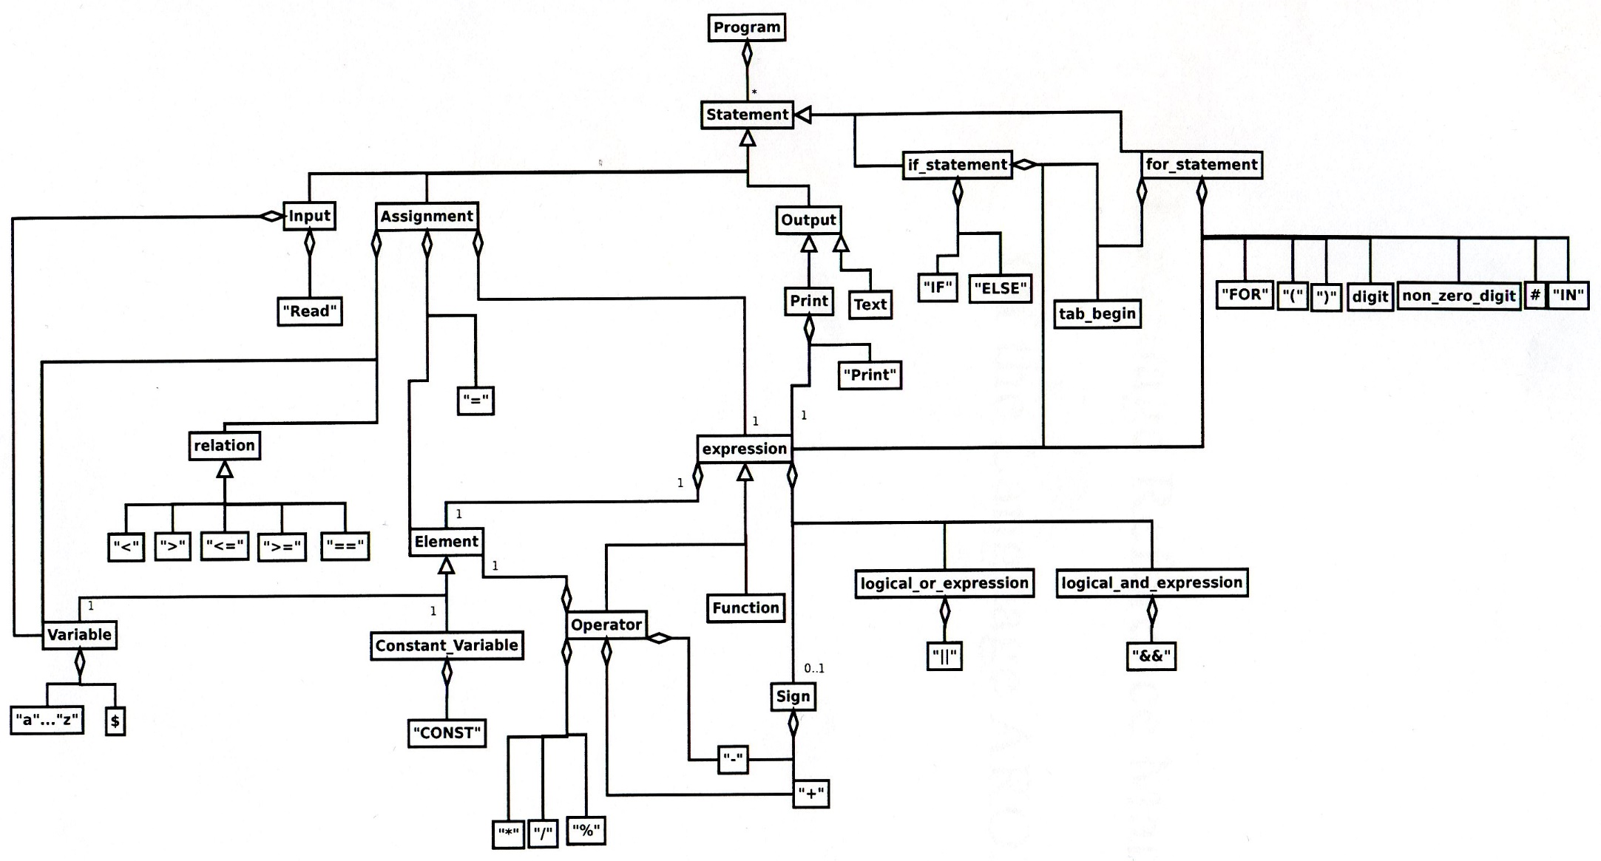
UML For AROZ

Slide 4
Name of Variables
Variable::=“$”identifier
Identifier::= letter#(letter|digit)
Letter::= “a”..”z”|”A”..”Z”
Digit::= “0”..”9”
Constant_variable::= “CONST” variable
Ex: $a
$studentName
$student23Gender
CONST $student

Slide 5
Keyword: uppercase
Ex: BEGIN, END, READ, PRINT, CONST
Program begins with “BEGIN”, and ends with “END”
Ex: BEGIN
READ $a
$b = $b * $a
PRINT $b
END

Slide 6
Declare a variable
CONST $studentName = “Jack” // Data Type: Constant String
$speed = 23 // Data Type: Integer
$i = 2.563 // Date Type: Double
$score = [88, 89, 75, 99, 63] // Data Type: Array

Slide 7
Operators and Precedence
multiplicative_operator: *, /, %
additive_operator: +, -
logical_and_expression: &&
logical_or_expression: ||
Relation : >, <, <=, >=, ==
assignment_expression: =

Slide 8
FOR Statement
For statement: IN means in the range of (initial point, end of point, and increment by what number or decrement by what number). All the statement under the for-statement begins with a tab instead of {}, so that will make a prefect block which is easy to read and write.
Ex:
$sum = 0
FOR $i IN (0, 5, +1)
$sum= $sum + $i
PRINT $sum

Slide 9
IF statement
If statement: each statement within a line, and all the statements under the if-statement and else-statement begin with a tab. Same level of IF, ELSE should begin with a same vertical line.
Ex:
IF $i == 3
$i + 10
IF $i > 20
$i + 10
ELSE
$i – 10
ELSE
$i - 10

